Slide 1

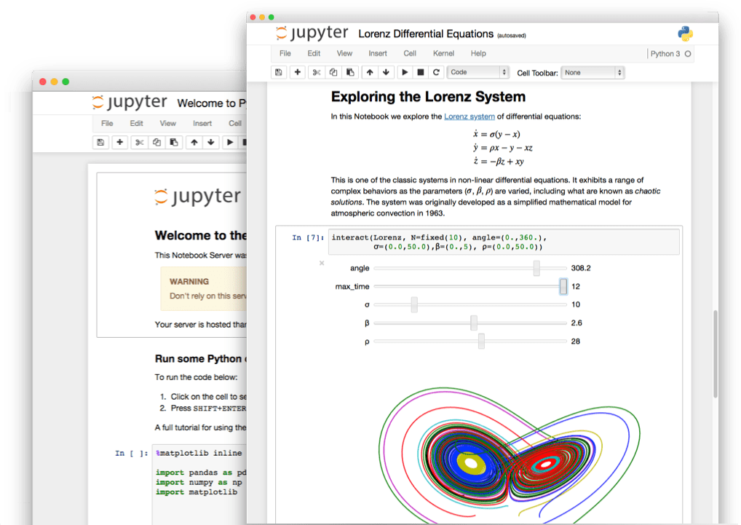
Overview Jupyter notebook
Spring 2020 - week #1
Notes:
J

Slide 2
What is a Jupyter notebook?
Open source web application
Development started in 2014 as spin-off from IPython
Notebooks denotes documents that contain both
Code, and rich text elements (figures, links, equations, etc)
Notebook documents produced by the Jupyter Notebook App
Client-server application to edit and run notebooks
Two main components: the kernels and a dashboard
Jupyter is a loose acronym meaning Julia, Python and R
Nowadays, Jupyter supports many other languages

Slide 3
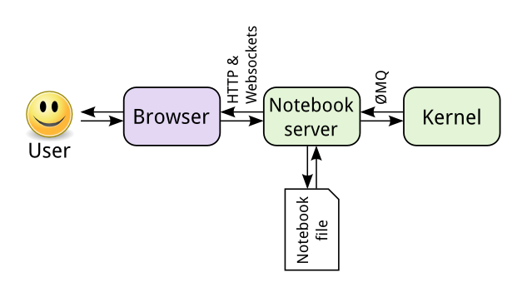
Jupyter is language-agnostic
The notebook server is responsible for saving and loading notebooks
The notebook is saved as a JSON file
The kernel gets sent cells of code to execute

Slide 4
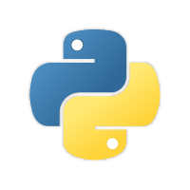
Crash-course in Python 3.x
Spring 2020 - week #1
Notes:
J

Slide 5
Brief history of Python
Open source programming language
Conceived in the Netherlands by Guido van Rossum
Implementation started in December 1989
Python 2.x is legacy, Python 3.x is the present & future of the language
Python 2.0 released on October 16, 2000 (current: 2.7.15)
Python 3.0 released on December 3, 2008 (current: 3.7.3)
High-level, portable, interpreted, object-oriented

Slide 6
Why Python?
Easy, Fast & Broad
Python Has a Healthy, Active and Supportive Community
Plenty of documentation, guides, tutorials and more
Incredibly active developer community
Python Has Some Great Corporate Sponsors
Google!
Python has Extensive Libraries

Slide 7
Python 3.x references
https://docs.python.org/3.7/tutorial/
Books include:
Learning Python by Mark Lutz
Python Essential Reference by David Beazley
Python for Data Analysis by William McKinney
https://github.com/justmarkham/DAT8#python-resources
Python Quick Reference
https://github.com/justmarkham/python-reference

Slide 8
Common pitfalls in Python
Incorrect indentation, tabs and spaces
Never use tabs, only spaces (4)
Using a mutable value as a default value
Scoping (local vs global variable)
Copying vs referencing (mutable types)

Slide 9
A few exercises in Python
Open the DSLab Week 1-1 Jupyter notebook
./notebooks/DSLab_week1_1.ipynb
Generators
List comprehension
Lambda Operator and the functions map() and reduce()
Lists of characters and the functions join() and append()

Slide 10
NumPy, Pandas,
scikit-learn &
Matplotlib
Spring 2020 - week #1

Slide 11
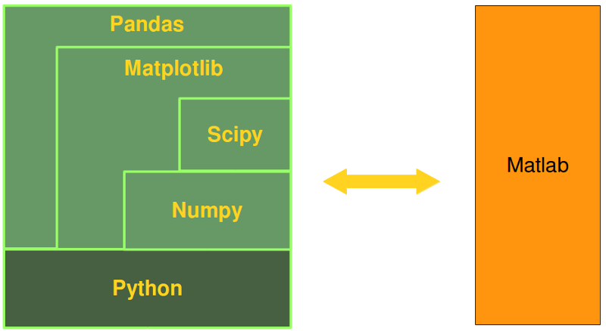
Python alternative to Matlab

Slide 12
Python libraries for (aspiring) data scientists
NumPy: Work with large multidimensional arrays and matrices
Pandas: Do data wrangling
Matplotlib: Make line graphs, pie charts, histograms, etc
Scikit-learn: Build machine learning models

Slide 13
NumPy & Data Types
Core library for scientific computing in Python
Provides a high-performance multidimensional array object, and tools for working with these arrays
A NumPy array (ndarray) is a grid of values, all of the same type
indexed by a tuple of nonnegative integers
the shape of an array is the size of the array along each dimension

Slide 14
Python lists vs NumPy arrays
Functionality: SciPy and NumPy have optimized functions such as linear algebra operations built in
Performance: need for speed and are faster than lists
Size: Numpy data structures take up less space
list: 64 + n*8 + n*28 bytes
ndarray: 96 + n*8 bytes
a.
b.

Slide 15
Relevant NumPy functions
arange([start,] stop[, step], [, dtype=None])
linspace(start, stop, num=50, endpoint=True, retstep=False)
Checkout logspace & geomspace
reshape(array, newshape, order=‘C’)
copy(obj, order='K’)
Indexing and slicing arrays

Slide 16
What is Matplotlib?
Plotting library

Slide 17
Relevant Matplotlib functions
Functions: plot, subplot, scatter and annotate
%matplotlib {inline, notebook}
matplotlib.get_backend()

Slide 18
Other visualization libraries
Seaborn: Python's Statistical Data Visualization Library
high-level interface to draw statistical graphics
https://seaborn.pydata.org/
Bokeh: Python interactive visualization library
interactive plots, dashboards, and data applications
https://bokeh.pydata.org/en/latest/

Slide 19
Pandas & Pandas Data Frames
Powerful & flexible data munging library
Pandas was built on NumPy
NumPy stores your data in arrays
Pandas takes the NumPy Array…
… and gives you a labeled index to it
Pandas DataFrame is a 2-D labeled data structure with columns of potentially different types
Basically, dictionary-based NumPy arrays
Recommended reading (before doing the exercises)
https://chrisalbon.com/python/data_wrangling/pandas_apply_operations_to_groups/

Slide 20
Scikit-learn: Machine Learning in Python
http://scikit-learn.org/stable/index.html
Open source, built on NumPy, SciPy, and matplotlib
Classification
Regression (Logistic Regression)
Clustering (KMeans)
Dimensionality reduction (PCA)
Model selection
Preprocessing

Slide 21
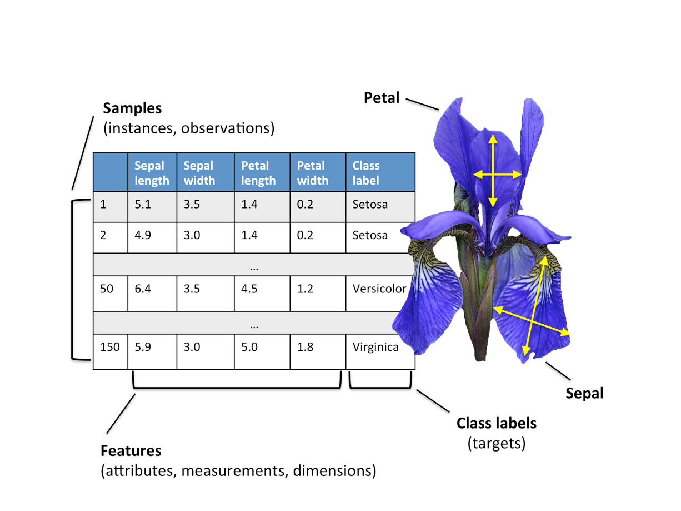
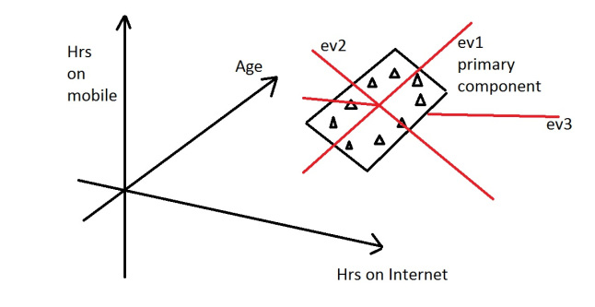
Principal Component Analysis (PCA)
sklearn.decomposition.PCA()
(Linear) dimensionality reduction using SVD of the data to project it to a lower dimensional space
Maximize the variance in the low-dimensional representation
Take e.g. the Iris dataset
Example

Slide 22
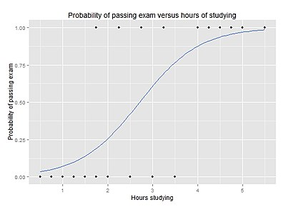

Logistic Regression
sklearn.linear_model.LogisticRegression()
Model used for prediction of the probability of occurrence of an event by fitting data to a logistic curve
Standard industry workhorse!
Chaining a PCA and a logistic regression

Slide 23
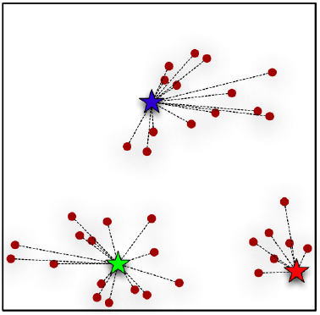
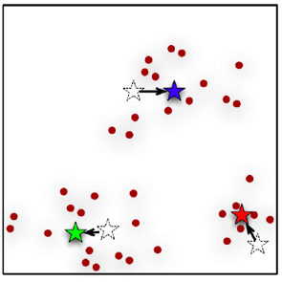
Kmeans – Clustering algorithm
sklearn.cluster.KMeans()
Find similarity groups in a data, called clusters
Randomize K points, then two-step iterative algorithm:
1. Cluster assignment step
2. Move centroid step.

Slide 24
Exercises … a bit harder/longer
Open DSLab Week 1 Jupyter notebooks in Renku
./notebooks/DSLab_week1-2.ipynb
NumPy arrays & Matplotlib
./notebooks/DSLab_week1-3.ipynb
Getting familiar with Pandas
Simple Machine Learning problems

Slide 25
Thank you!

